Slide 1


Slide 2

Boston, Airbnb
Prices
Predictions
Group 6 Final Group Project
December 2020

Slide 3

ABOUT THE PROJECT
Using the Boston Airbnb Prices dataset to formulate a machine learning model for predicting rent prices via regression techniques, feature selection and regularization.

Slide 4
Resources and Software Summary
Technology and Library
Dataset
Language
Boston Airbnb dataset
Jupyter Notebook
Pandas
SciKitLearn
Plotly
SciPy
Seaborn
PostgreSQL
SQLAlchemy
VS Code
Tableau
GitHub
Python 3.7
SQL
Javascript
HTML
Extract & Exploration
Transformation & Analysis
Load
Machine Learning
Outcomes and Dashboard
Notes:
We had 3 dataset to start the analysis
5 different technology
And 5 different languages

Slide 5
WHAT WE ARE WORKING ON
SUBWAY STATIONS
Jupiter is a gas giant and the biggest planet in our Solar System. It’s the fourth-brightest object in the sky
Week 1
Week 2
Week 3
Week 4
Extract & Exploration
Transformation & Load
Machine Learning
Storytelling
Extracted Boston Airbnb Prices dataset
Evaluated possible correlations between the features and rent prices
Explored if the features affect rent prices
Made sure the data is integrated fully and that it interfaces the project
Organized and cleaned data tables in Postgresql
Prepare data for machine learning
Created a user-interactive website where the prediction model is applied and data is stored
Created dashboard and embedded it onto the website
Applied multiple linear regression and deep learning model to train and test the data
Yes, Saturn is the ringed one. This planet is a gas giant, and it’s composed mostly of hydrogen and helium

Slide 6

Analysis

Slide 7
Machine Learning Model
1: Import necessary dependencies
2: Connect to the database
3: Data manipulation
Take a log of both the features and target to make them more normally distributed
Use label encoder to transform categorical features to numerical
4: Set X and y
X = features where y = target

Slide 8
Machine Learning Model
5: Scale both X and y
6: Split the data into training set and testing set
we did a 80/20 split
check the shape of each set
7: Define the model
8: Fit the model and time the model
9: Run prediction on testing set
10: print the coefficient, intercept, MSE and model score(R^2),and model run time

Slide 9
Multiple Linear Regression
estimates the relationship between several independent variables (features) and one dependent variable.
Advantages
allows us to determine the relative influence of more than one predictor variables to the target variable.
enables us to identify outliers (find out the features that have a strong correlations and the ones that do not)
it is fast to run the model
Disadvantages
the size of the sample may lead to the pitfall of incomplete data
predictor values provide insights for limited features
If we want to create any linear model, it is essential that the features are normally distributed. This is one of the assumptions of multiple linear regression.

Slide 10
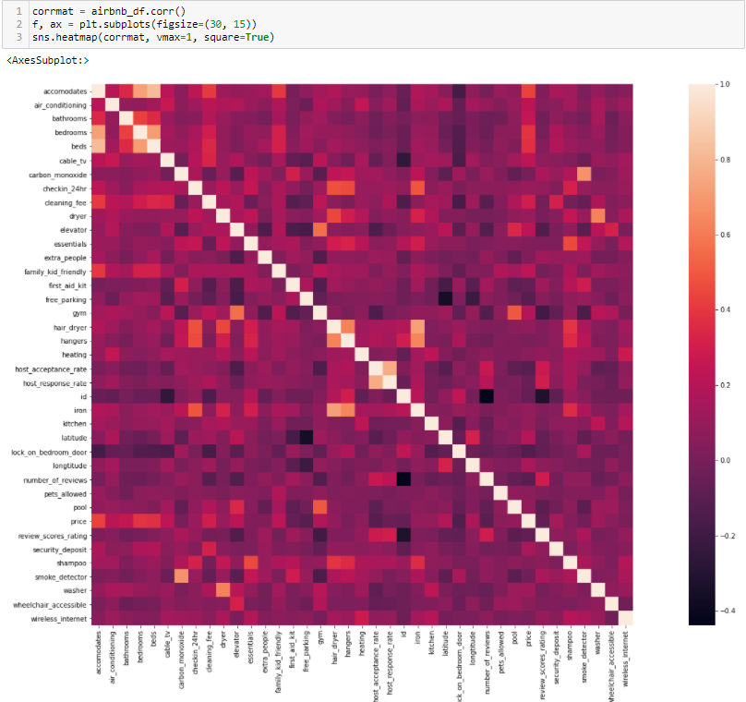
Features Correlation
Use the heatmap to find out the top 8 features that are the most correlated with sales price

Slide 11

Description of Interactive Elements
Navigation Bar
-including tabs to Dashboards, Machine Learning and Github Repository

Slide 12
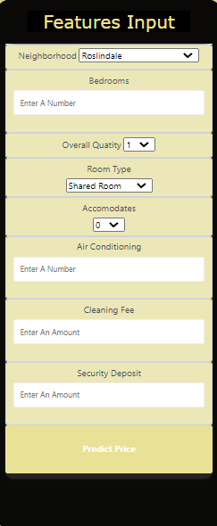
Description of Interactive Elements
Features Input
-including eight features in the model

Slide 13

PROJECT GOALS
Dataset Content

Slide 14
Description of Interactive Elements
Tableau Dashboards

Slide 15
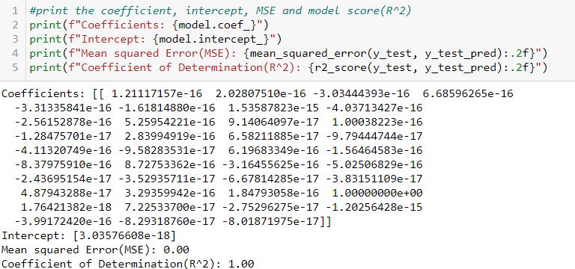
Model Statistics

Slide 16
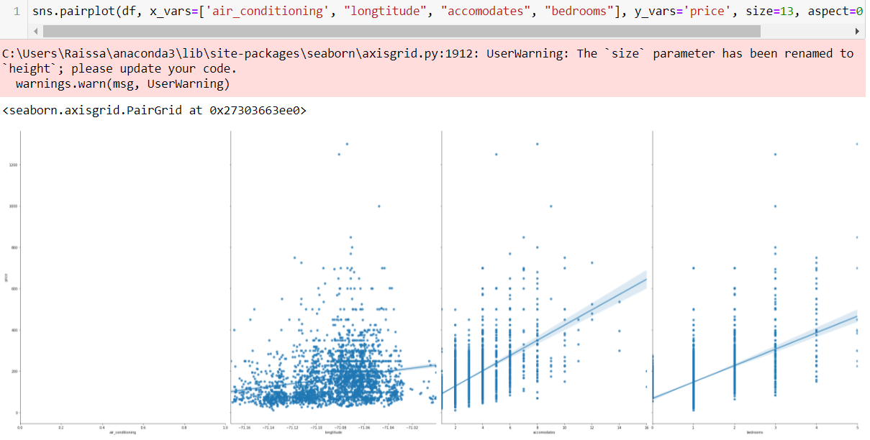
Features Correlation Graphs

Slide 17
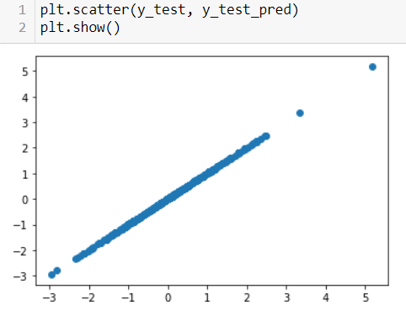
Multiple Linear Regression Model

